Slide 1
AI Expo 2025
SLT Global Business Solutions

Slide 2
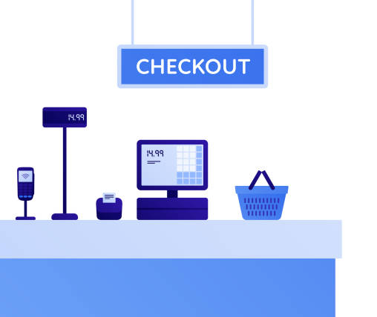
Unmanned store
Would you like to continently get your bills without a cashier at your supermarket checkout?
Our new machine learning model for object identification will do this for you.
Unmanned store for a hassle-free supermarket experience

Slide 3
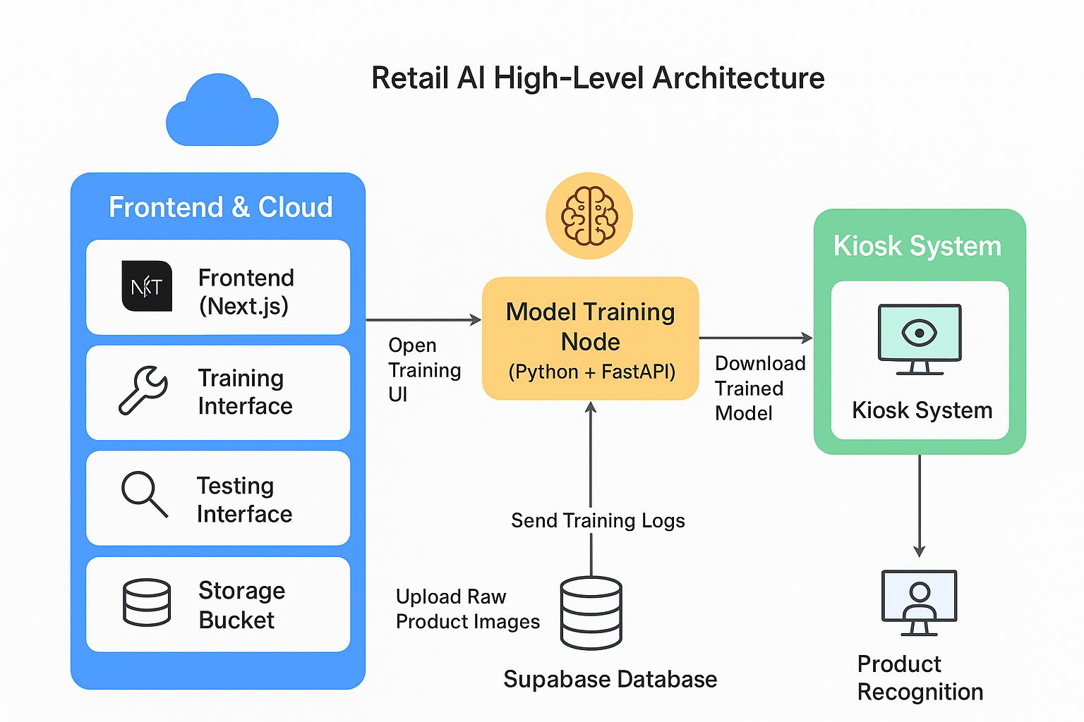
How Unmanned Store works

Slide 4
Image recognition

Slide 5
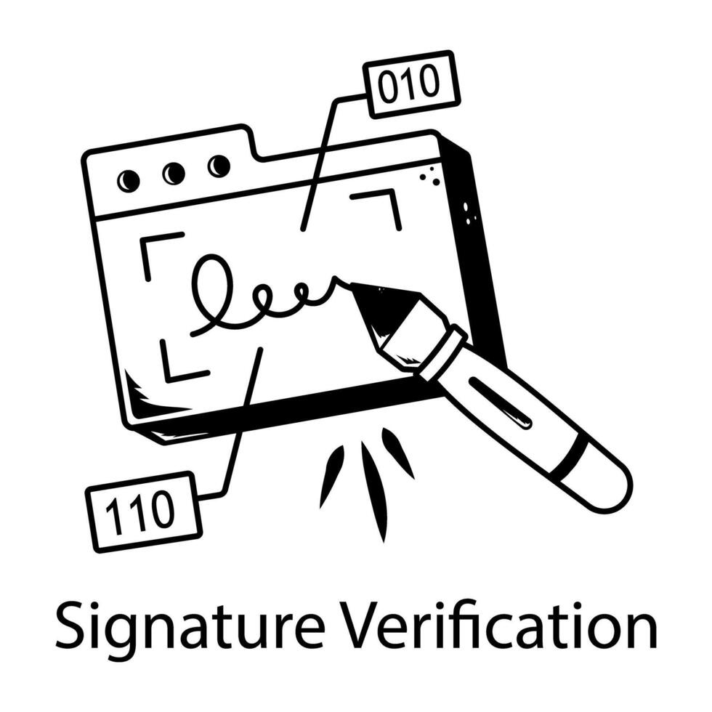
Signature Verification System
An AI-based offline signature verification system leverages Convolutional Neural Networks (CNNs) to authenticate handwritten signatures from scanned images
This system offers a secure and efficient solution for identity verification in banking, legal, and administrative applications.

Slide 6
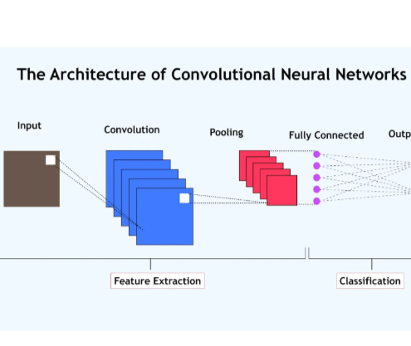
How Unmanned Store works
This model was tested with an accuracy of 97.6%.
A CNN is used to extract features from the signature image.
Extracted feature vector will be compared with a set of reference signatures to find a map
If a match is found it’s a genuine signature. Else it’s a forgery.

Slide 7

Signature Verification Output
If a matching signature is found within the threshold following details are given
Scanned Signature image
Reference Signature image
Similarity score
Otherwise, a message will be displayed as there are no matching signatures

